Slide 1

Master of Computer Application
University Institute of Technology
Rajiv Gandhi Proudyogiki Vishwavidyalaya
A
Major Project
On
Desktop Voice Assistant
Submitted By
Darakshan Khan
MCA (4 semester)

Slide 2
Contents
Introduction
Objective
Modules
Hardware Requirement
Software Requirement
How its work?
Flow chart
Use Case Diagram
Screenshot of Output
Advantages
Conclusion

Slide 3
Introduction of
Desktop Voice Assistant
An Desktop voice assistant is a software agent that can performs
tasks or services for an individual based on commands or questions.
Desktop voice assistant are able to interpret human. Speech and
respond via synthesized voices.

Slide 4
Objectives
This is easily operate your voice.
Search on web
Play a music or video
Run any program or application
Getting weather updates
To design simple user friendly system.

Slide 5
Modules
Modules needed
Pyttsx3 :- This module is used for the conversion of text to speech in a program it works offline.
Tkinter :- This module is used for building GUI and comes inbuilt with python.
Wikipedia :- We have used the Wikipedia module to get information form Wikipedia or to perform a Wikipedia search.
Speech Recognition :- We are building an application of voice assistant one of the most important things in this is that your assistant recognizes your voice.
Web browser :- To perform web search.
Pywhatkit :- It is used for playing songs on you tube.

Slide 6
Pyjokes :- Pyjokes is used for the collection of python Jokes over the internet.
Datetime :- Date and Time are used to showing date and time.
Requests :- Requests is used for making GET and POST requests.
BeautifulSoup :- Beautiful Soup is a library that makes it easy to scrape information from web pages.
WolframAlpha :- It is used to compute expert level answers using wolfram’s algorithms, knowledgebase and AI technology.
Ctypes :- Ctypes is a foreign function library for python.
Pyautogui :- Pyautogui to perform GUI and desktop automation using python.

Slide 7
Hardware & Software Requirement
Hardware requirement:-
Processor: intel i5 8 Gen
Storage: 128 GB SSD
RAM : 4 GB
Software requirement:-
IDLE (Python 3.10 64-bit)
PyCharm community edition 2022.3.11
OS: Windows 11

Slide 8
How it Works
Speak something.
Saira records the voice and match with available then proper response is provided.
Proper action is taken.
Search anything.
Calculation using wolframalpha API.
Search weather in any country.
It is used to write notes and show notes.

Slide 9
Flowchart
Start
Send voice command
Yes
Speech
User input speech or text
Is text
No
Speech Recognition
Yes
Response
Search
No
No Response
Execute Command
Console Output and search
Exit

Slide 10
Use Case Diagram
Desktop Voice Assistant
Triggered word
Welcome User
Input Command
User
Take Actions
Saira
Exit

Slide 11
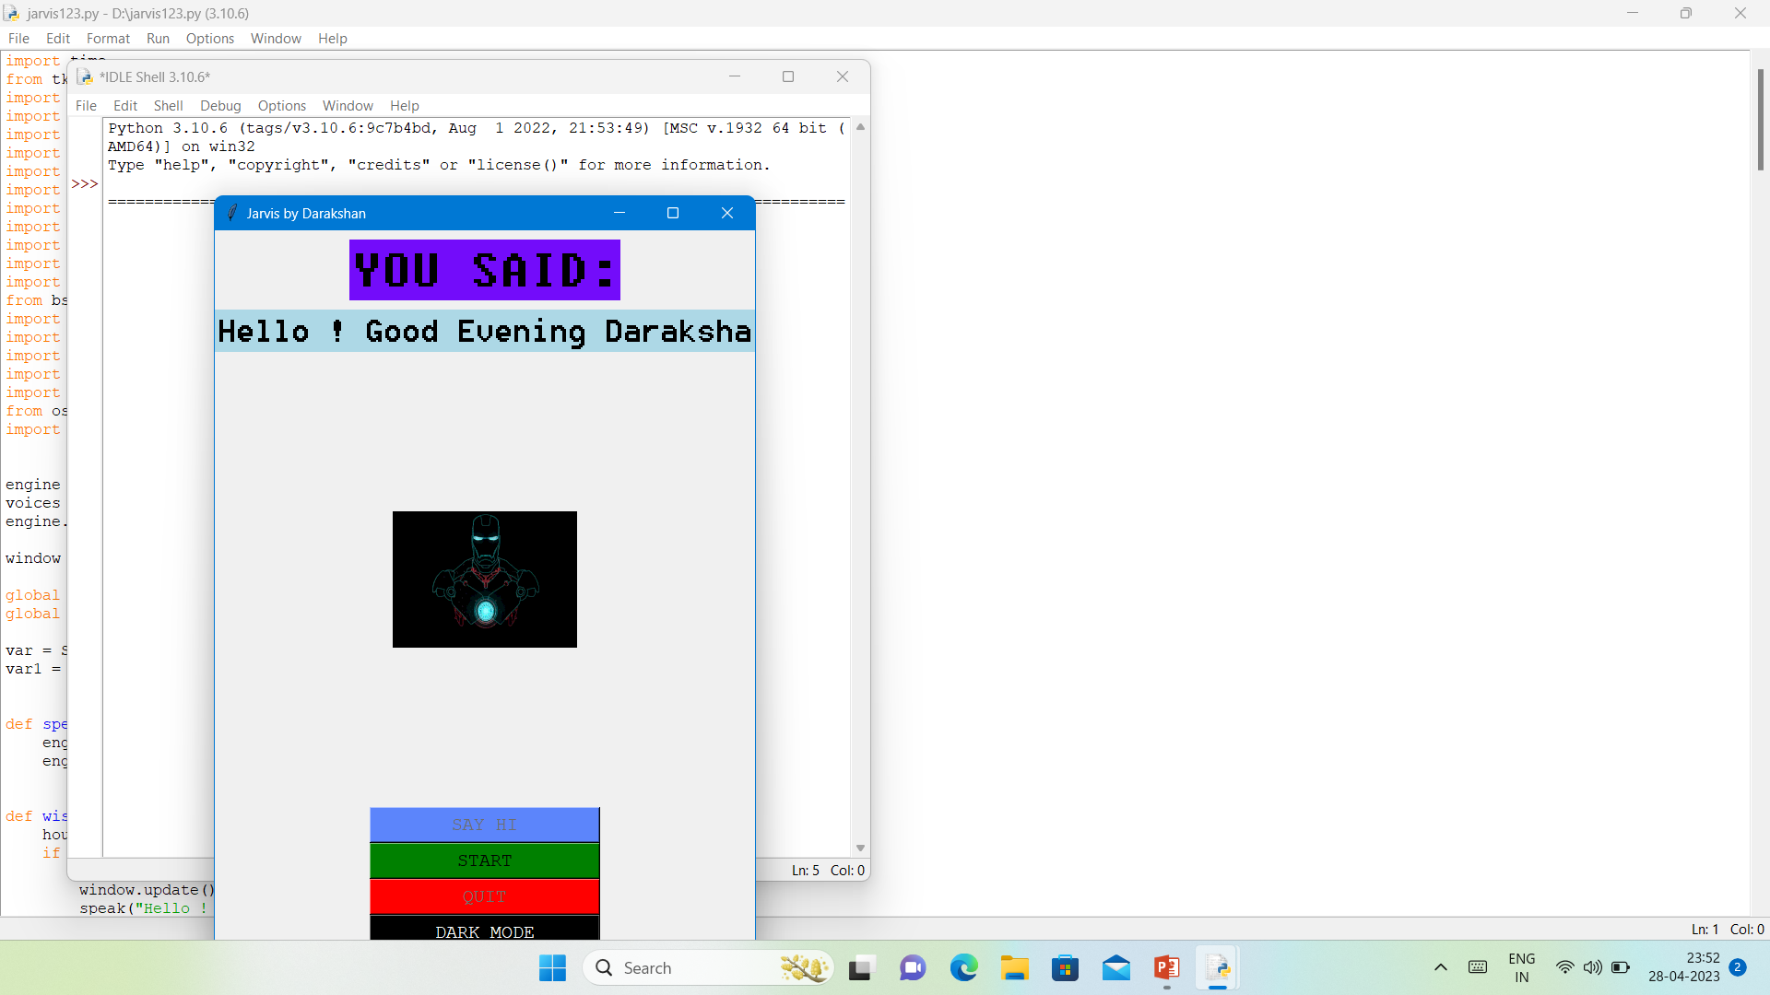
Screenshot of Output

Slide 12
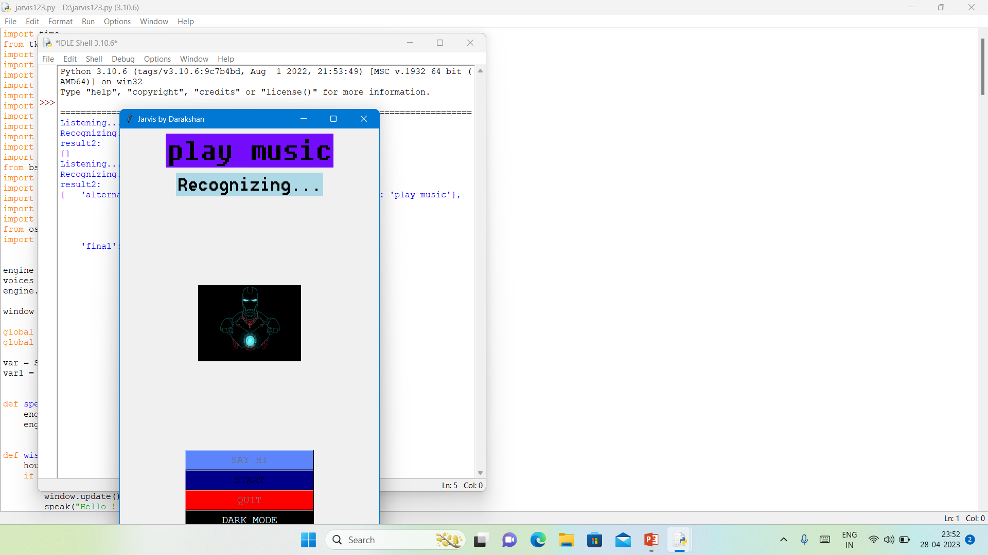
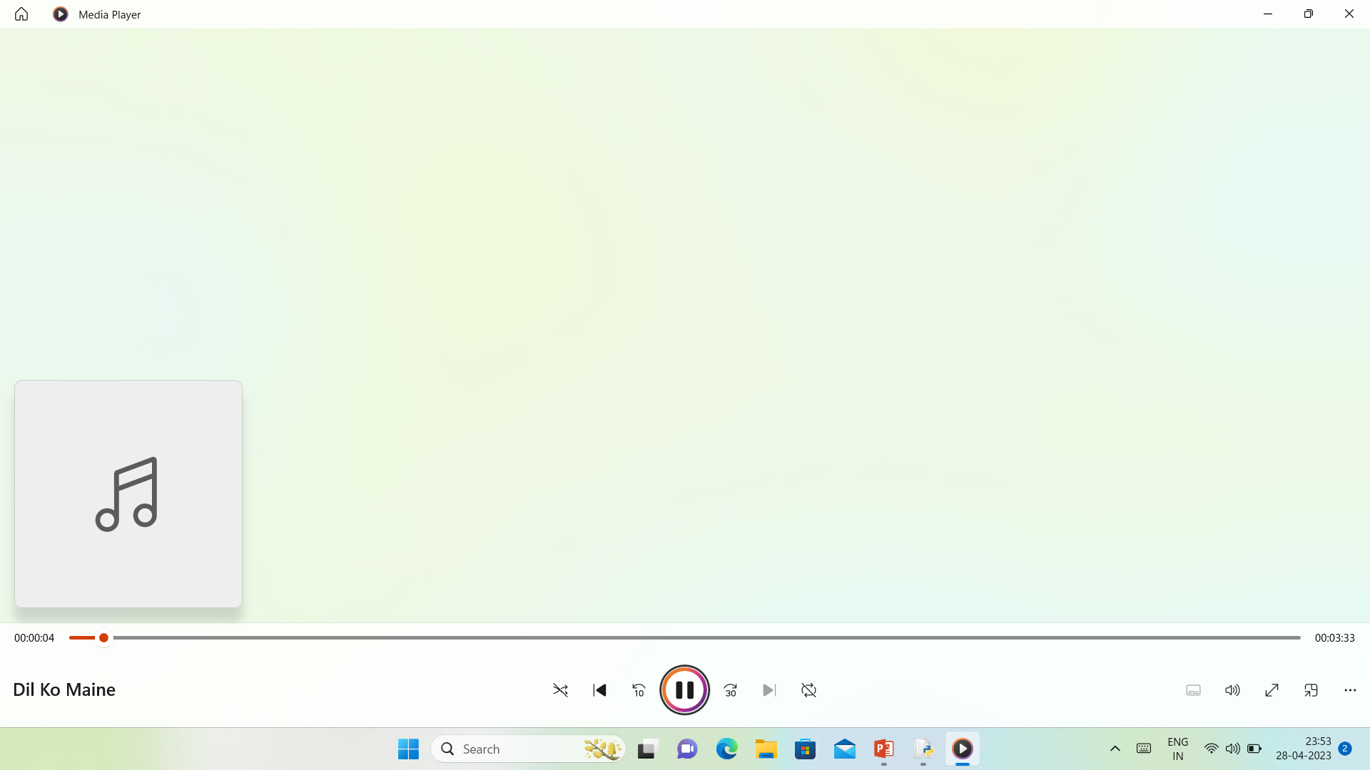

Slide 13
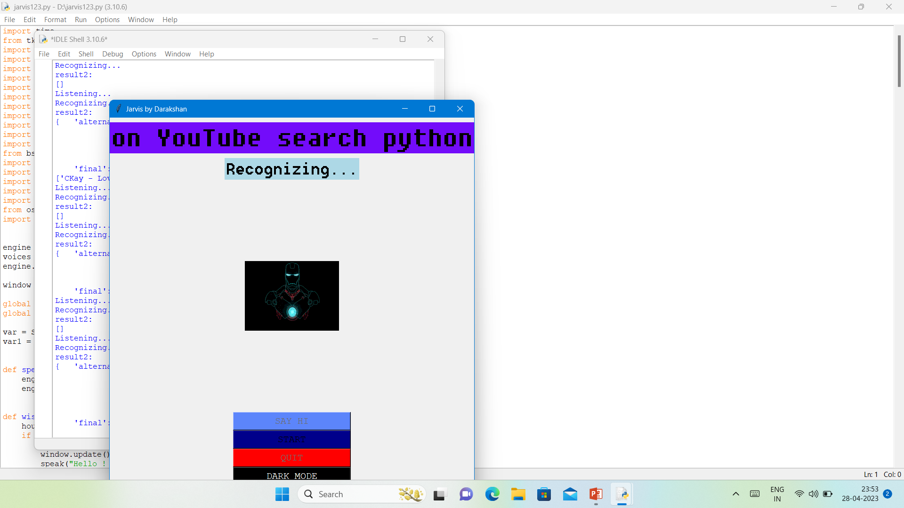
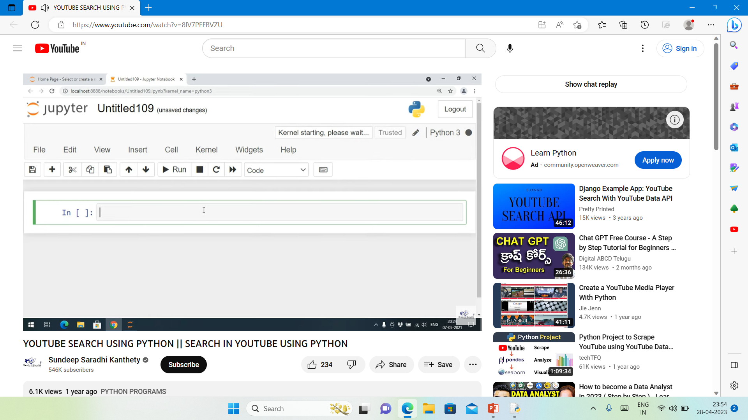

Slide 14
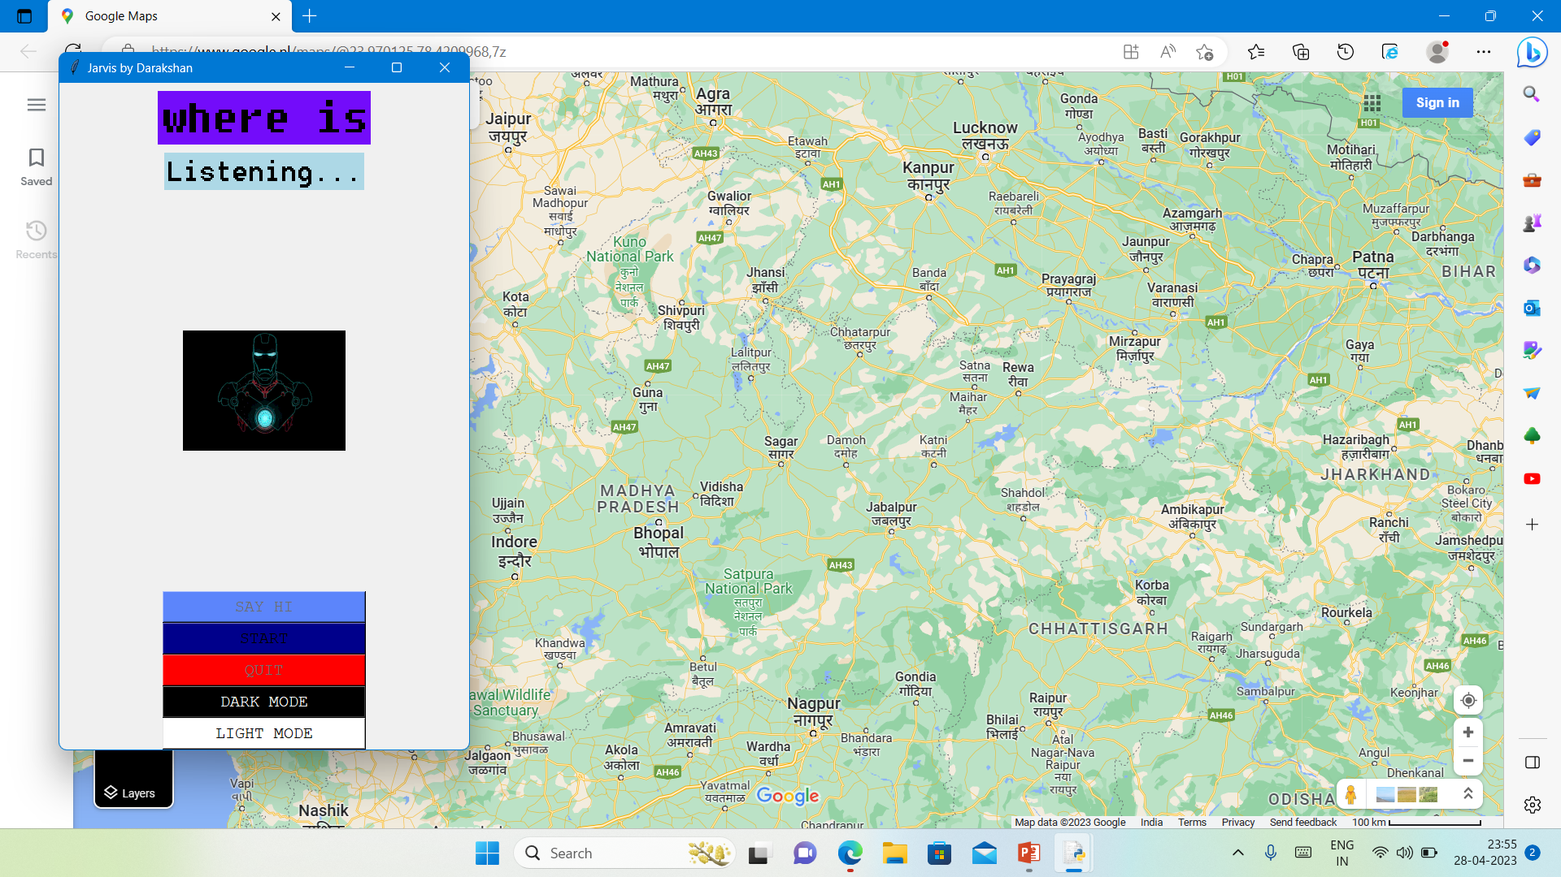

Slide 15
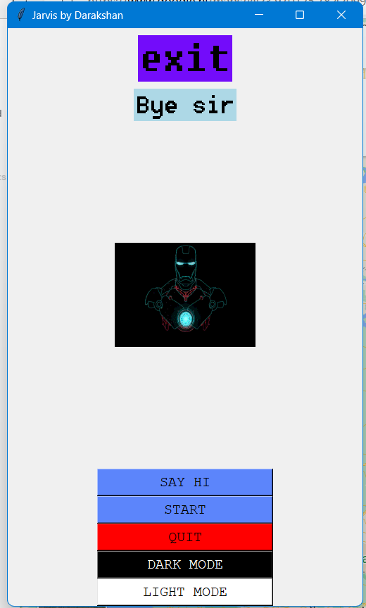

Slide 16
Advantages
Easy to use.
We can work with variety of commands
Secure
Easy to manage timesheet with voice assistant.
We can use them anywhere, anytime.
Hands-free.
Smart working environment.

Slide 17
Conclusion
The popularity of voice activated voice assistants, as well as their future potential, were examined in this study. Which may perform operations in audio format as directed by the user. It may open apps such as notepad, web searches, Wikipedia reading, audio player, and many others. These assistants make life easier for humans. We can use artificial intelligence and the internet of things to improve these gadgets.

Slide 18
Thank You

